Slide 1
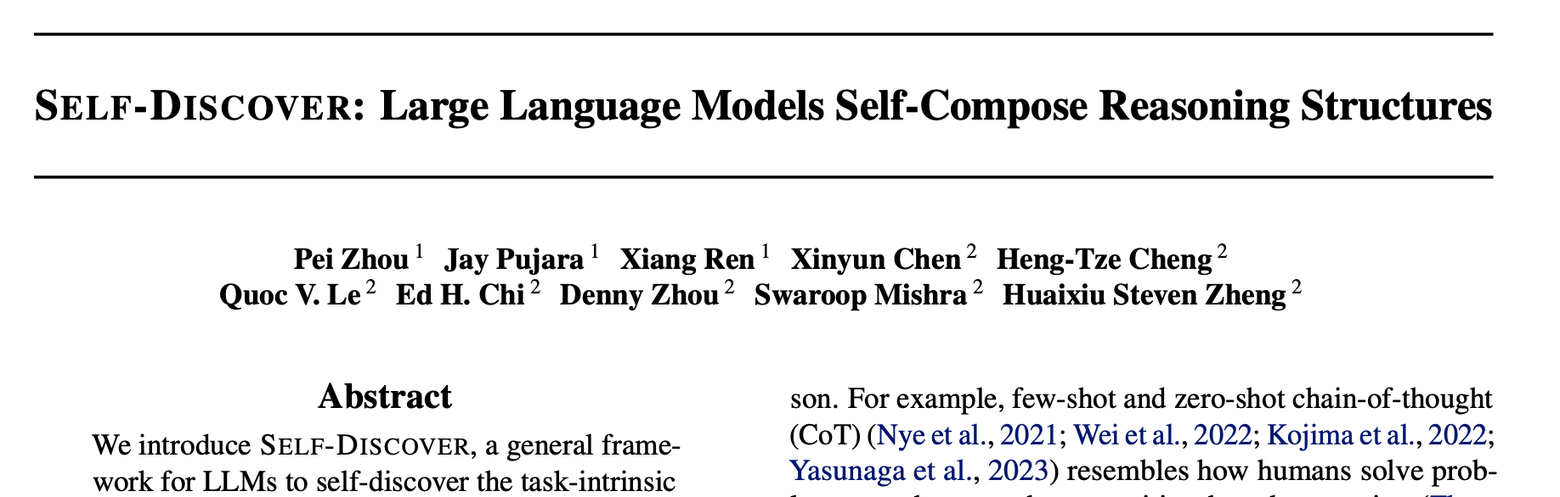
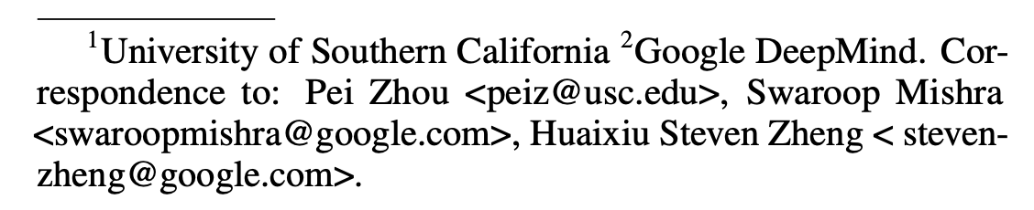
Self-Discover:
Large Language Models Self-Compose Reasoning Structures
Asim Munawar
Download PPTX
6 Feb 2024

Slide 2
Overview
A general frame-work for LLMs to self-discover the task-intrinsic reasoning structures to tackle complex reasoning problems that are challenging for typical prompting methods.
Core to the framework is a self-discovery process where LLMs select multiple atomic reasoning modules such as critical thinking and step-by-step thinking and compose them into an explicit reasoning structure for LLMs to follow during decoding.
Substantially improves GPT-4 and PaLM 2’s performance on challenging reasoning benchmarks such as BigBench-Hard, grounded agent reasoning, and MATH, by as much as 32% compared to Chain of Thought (CoT).
Outperforms inference-intensive methods such as CoT-Self-Consistency by more than 20%, while requiring 10-40x fewer inference compute.
Universally applicable across model families.

Slide 3
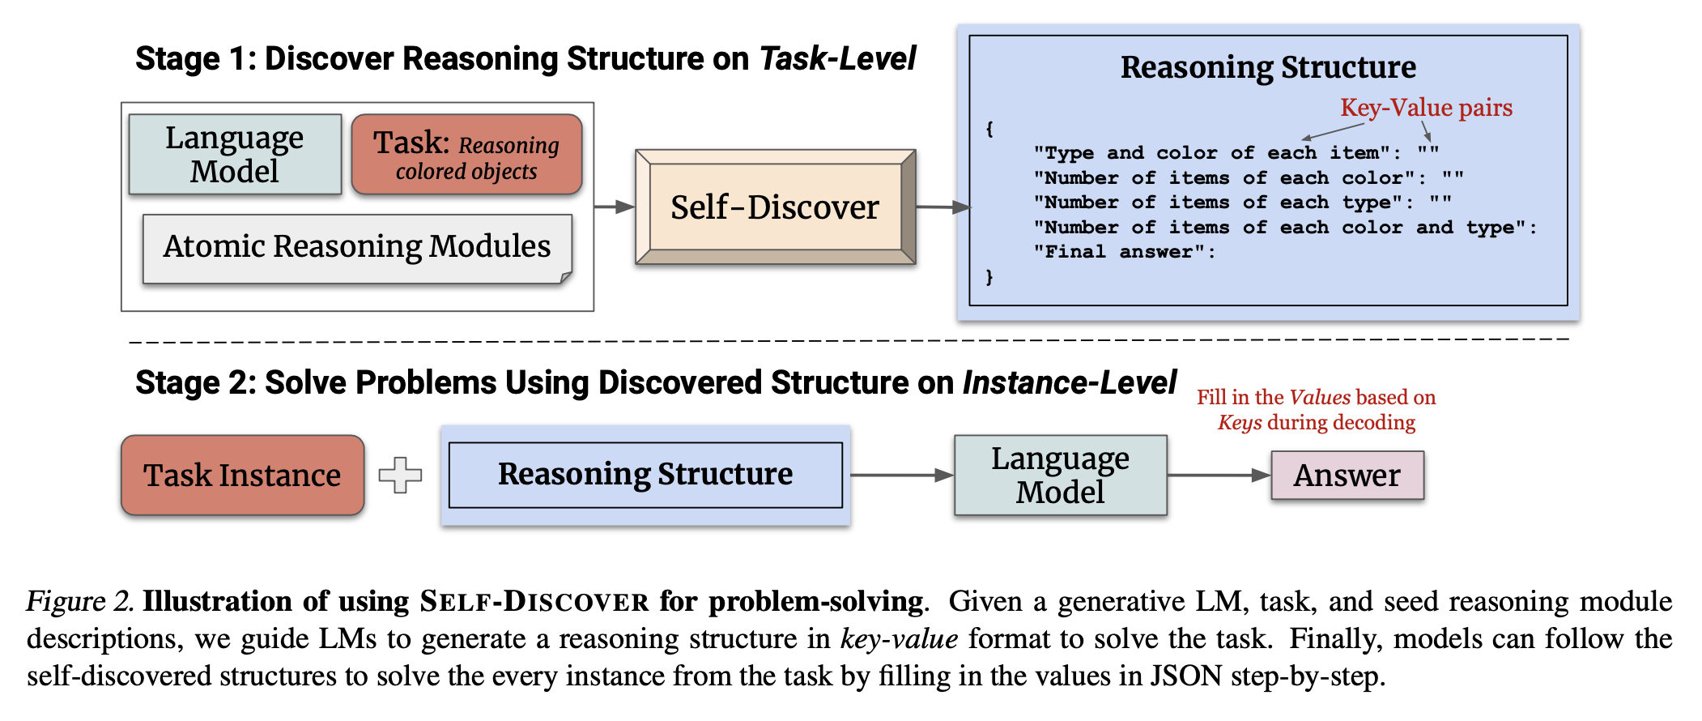
Introduction
SELF-DISCOVER, is inspired by how humans internally devise a reasoning program for problem-solving.
From a set of atomic reasoning modules described in natural language such as “breakdown into sub tasks” and “critical thinking”, SELF-DISCOVER composes a coherent reasoning structure intrinsic to the task and then execute it.

Slide 4
Comparison with Related work
A fundamental limitation is that each technique itself serves as an atomic reasoning module making an implicit prior assumption of the process on how to tackle a given task.
Argue that each task has a unique intrinsic structure underlying the reasoning process involved in solving it efficiently. For instance, least-to-most prompting has shown to be better than CoT.

Slide 5
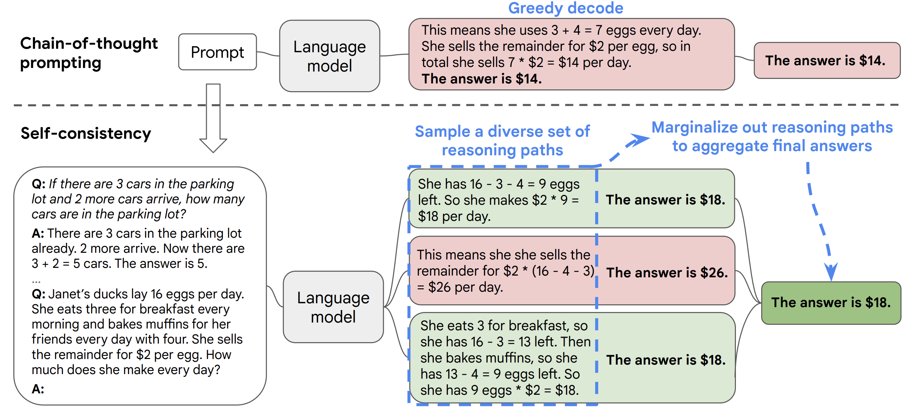
CoT with Self-Consistency
Xuezhi Wang, SELF-CONSISTENCY IMPROVES CHAIN OF THOUGHT REASONING IN LANGUAGE MODELS, https://arxiv.org/abs/2203.11171 (March 2022)

Slide 6
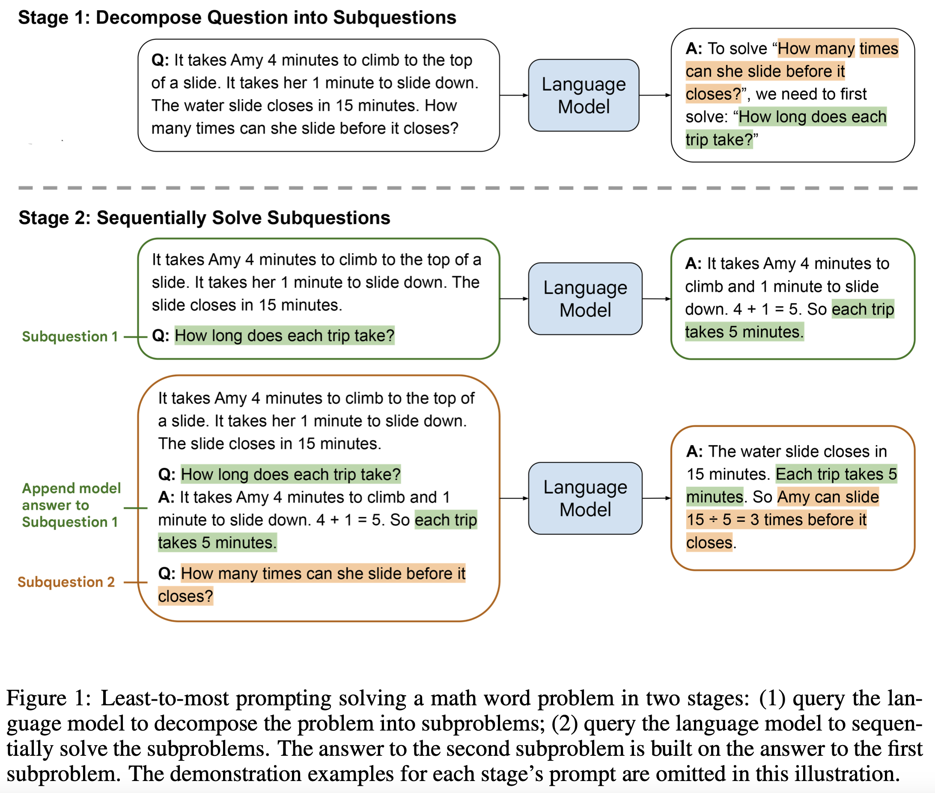
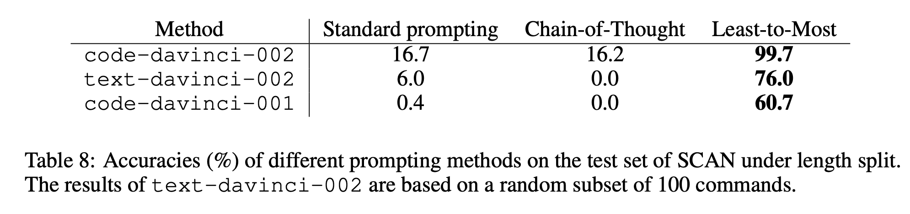
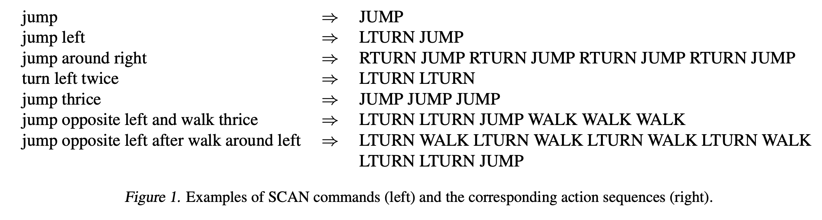
Least-to-Most Prompting
Denny Zhou et al. LEAST-TO-MOST PROMPTING ENABLES COMPLEX REASONING IN LARGE LANGUAGE MODELS
https://arxiv.org/pdf/2205.10625.pdf
SCAN (Lake & Baroni, 2018) is arguably the most popular benchmark for evaluating compositional generalization.

Slide 7
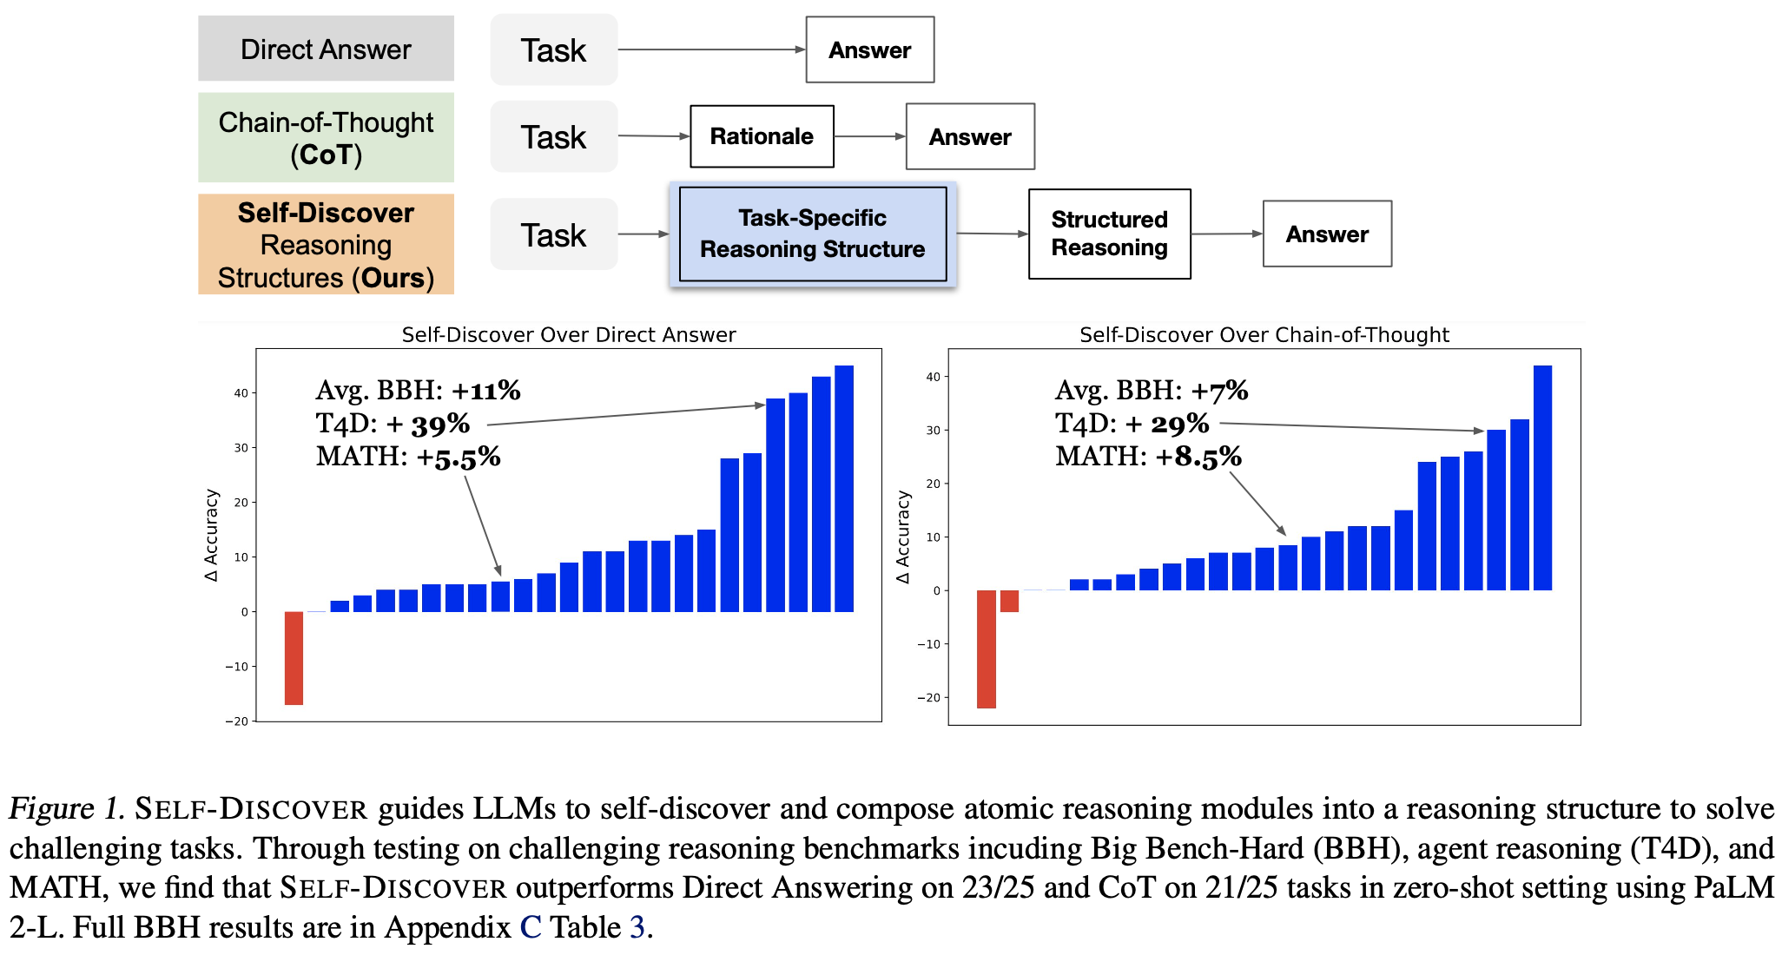

Slide 8
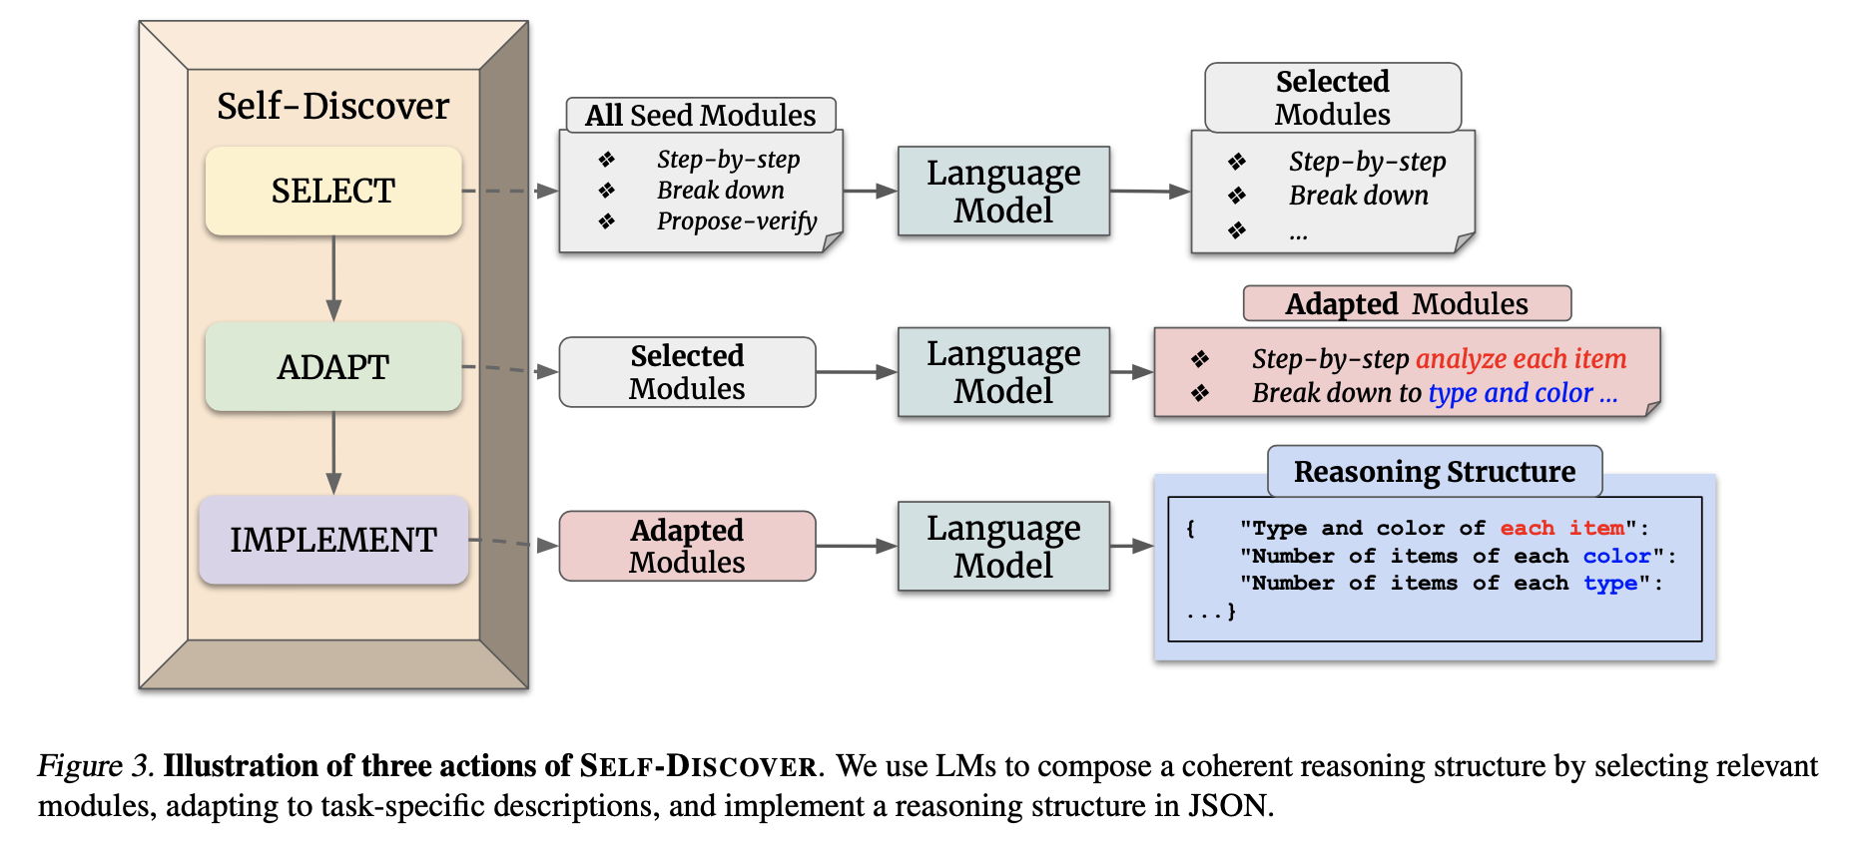

Slide 9
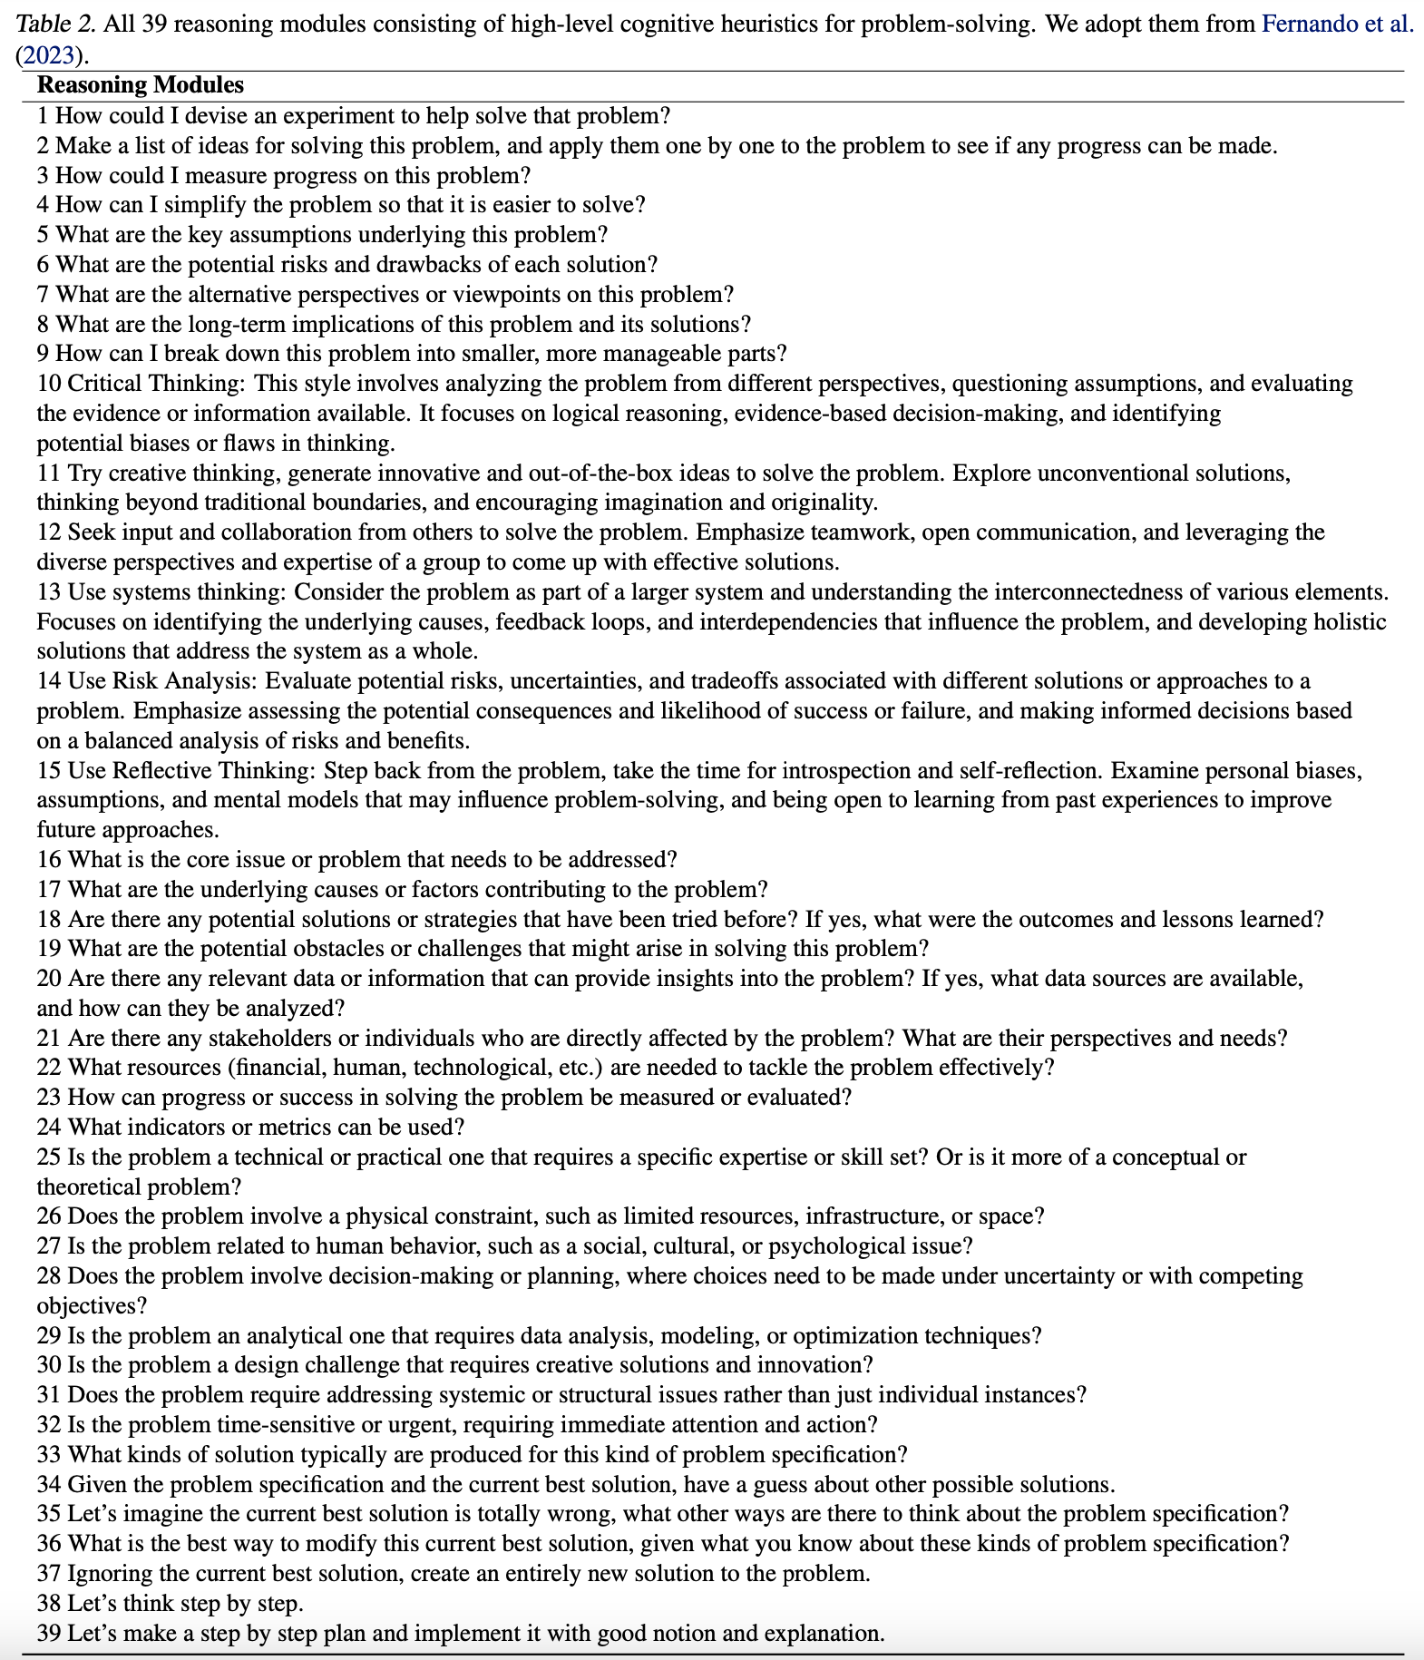
39 Reasoning Modules consisting of high-level cognitive heuristics for problem-solving (Adopted from existing work)

Slide 10
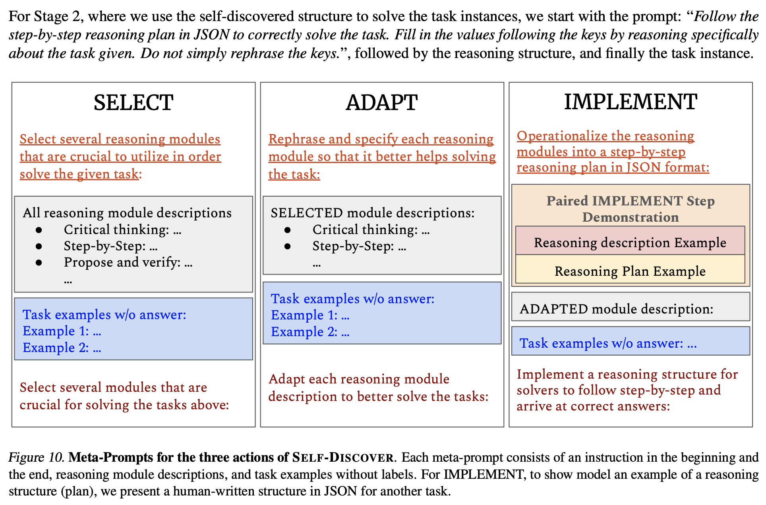
Prompts

Slide 11
Example: Using SELF-DISCOVER for a Word Problem
Source: https://github.com/catid/self-discover
Implementation: https://github.com/catid/self-discover/blob/main/self_discover.py
….
….
….
task_example = "Lisa has 10 apples. She gives 3 apples to her friend and then buys 5 more apples from the store. How many apples does Lisa have now?”
selected_modules = select_reasoning_modules(task_example, reasoning_modules)
print("Stage 1 SELECT: Selected Modules:\n", selected_modules)
adapted_modules = adapt_reasoning_modules(selected_modules, task_example)
print("\nStage 1 ADAPT: Adapted Modules:\n", adapted_modules)
reasoning_structure = implement_reasoning_structure(adapted_modules, task_example)
print("\nStage 1 IMPLEMENT: Reasoning Structure:\n", reasoning_structure)
result = execute_reasoning_structure(reasoning_structure, task_example)
print("\nStage 2: Final Result:\n", result)

Slide 12
Example: Using SELF-DISCOVER for a Word Problem
Source: https://github.com/catid/self-discover
Lisa has 10 apples. She gives 3 apples to her friend and then buys 5 more apples from the store. How many apples does Lisa have now?
(The answer is 12.)
Stage 1 SELECT: Selected Modules:
9. How can I break down this problem into smaller, more manageable parts?
The problem can be broken down into two parts: first, calculating how many apples Lisa has after giving some away, and second, calculating how many apples she has after buying more. This approach simplifies the problem and makes it easier to solve.
Additionally, 10. Critical Thinking: This style involves analyzing the problem from different perspectives, questioning assumptions, and evaluating the evidence or information available. It focuses on logical reasoning, evidence-based decision-making, and identifying potential biases or flaws in thinking.
Critical thinking is always relevant in problem-solving as it helps to ensure that the solution is based on sound reasoning and evidence. In this case, it can help to confirm that the problem is being interpreted correctly and that the solution is logical and accurate.
Therefore, both 9 and 10 are relevant reasoning modules for this problem.
Stage 1 ADAPT: Adapted Modules:
1. Breaking down the problem:
The problem can be broken down into two smaller tasks:
a) Calculate how many apples Lisa has after giving 3 to her friend.
b) Calculate how many apples Lisa has after buying 5 more apples from the store.
By breaking down the problem into these smaller tasks, it becomes easier to solve.
2. Critical thinking:
Apply critical thinking to ensure that the problem is being interpreted correctly and that the solution is logical and accurate. This involves:
a) Confirming that the problem is understood correctly (Lisa starts with 10 apples, gives away 3, and buys 5 more).
b) Ensuring that the order of operations is followed correctly (subtracting the apples given away before adding the apples bought).
c) Double-checking the calculations to ensure accuracy.
By applying critical thinking, you can be confident that the solution is based on sound reasoning and evidence.
Stage 1 IMPLEMENT: Reasoning Structure:
Breaking down the problem:
a) Calculate how many apples Lisa has after giving 3 to her friend:
- Lisa starts with 10 apples
- She gives away 3 apples
- Subtract the number of apples given away from the initial number of apples
b) Calculate how many apples Lisa has after buying 5 more apples from the store:
- After giving away 3 apples, Lisa has a certain number of apples left (from task a)
- She then buys 5 more apples
- Add the number of apples bought to the remaining number of apples
2. Critical thinking:
a) Confirm that the problem is understood correctly:
- Lisa starts with 10 apples
- She gives 3 apples away
- She buys 5 more apples
b) Ensure that the order of operations is followed correctly:
- First, subtract the apples given away
- Then, add the apples bought
c) Double-check the calculations:
- Verify that the correct number of apples was subtracted
- Verify that the correct number of apples was added
By following this reasoning structure, you can solve the problem by breaking it down into smaller tasks, applying critical thinking, and double-checking your calculations. The final answer should be accurate and based on sound reasoning.
Stage 2: Final Result:
1. Breaking down the problem:
a) Calculate how many apples Lisa has after giving 3 to her friend:
- Lisa starts with 10 apples
- She gives away 3 apples
- Subtract the number of apples given away from the initial number of apples: 10 - 3 = 7 apples
b) Calculate how many apples Lisa has after buying 5 more apples from the store:
- After giving away 3 apples, Lisa has 7 apples left (from task a)
- She then buys 5 more apples
- Add the number of apples bought to the remaining number of apples: 7 + 5 = 12 apples
2. Critical thinking:
a) Confirm that the problem is understood correctly:
- Lisa starts with 10 apples
- She gives 3 apples away
- She buys 5 more apples
b) Ensure that the order of operations is followed correctly:
- First, subtract the apples given away (10 - 3)
- Then, add the apples bought (7 + 5)
c) Double-check the calculations:
- Verify that the correct number of apples was subtracted (10 - 3 = 7)
- Verify that the correct number of apples was added (7 + 5 = 12)
Final answer: Lisa has 12 apples now.

Slide 13
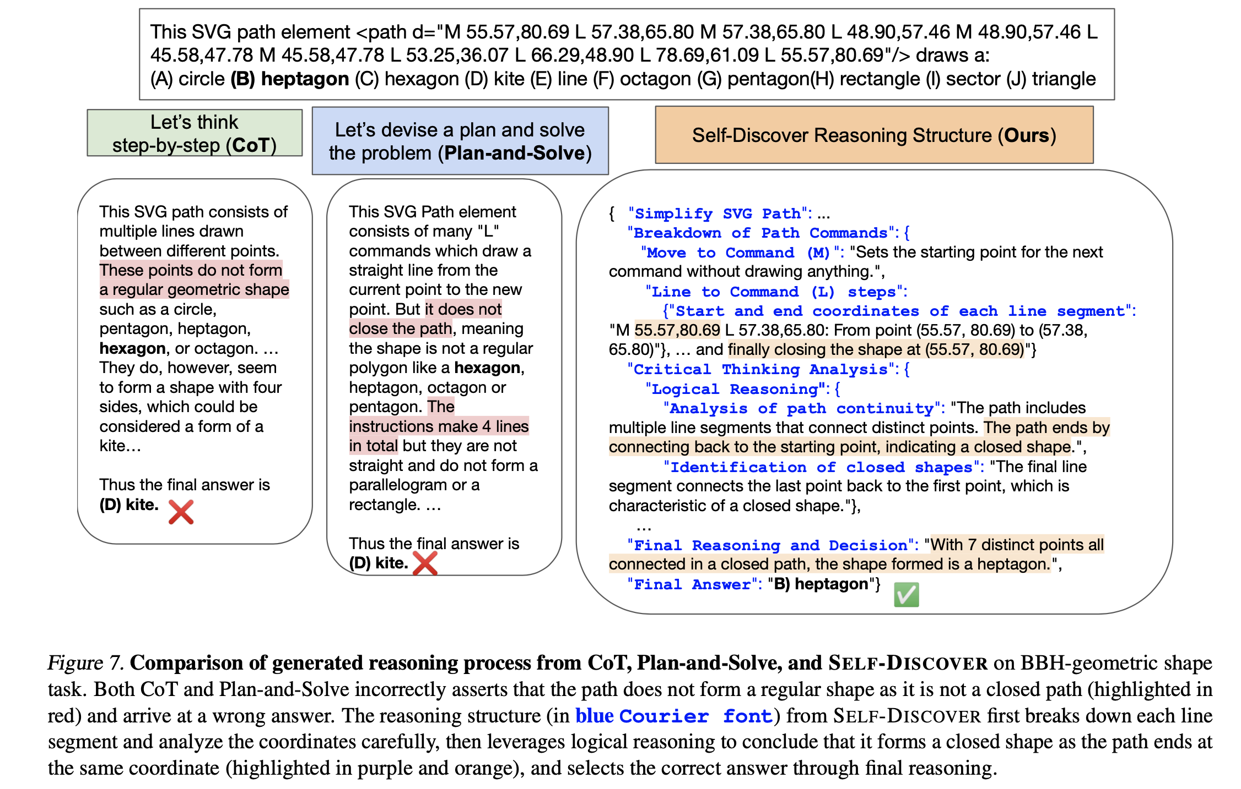
Example

Slide 14
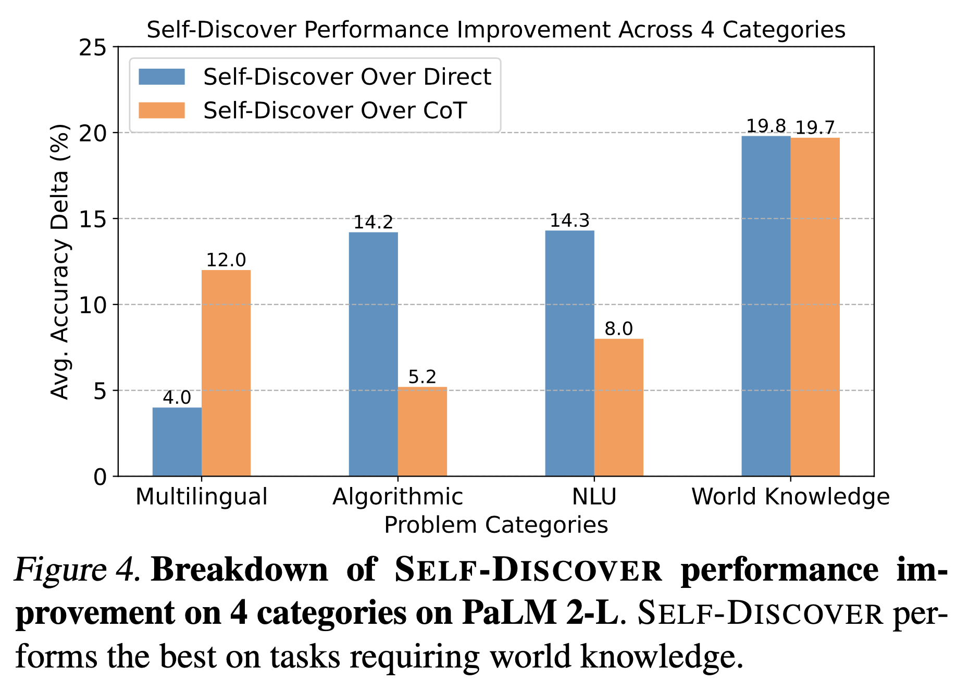

Slide 15
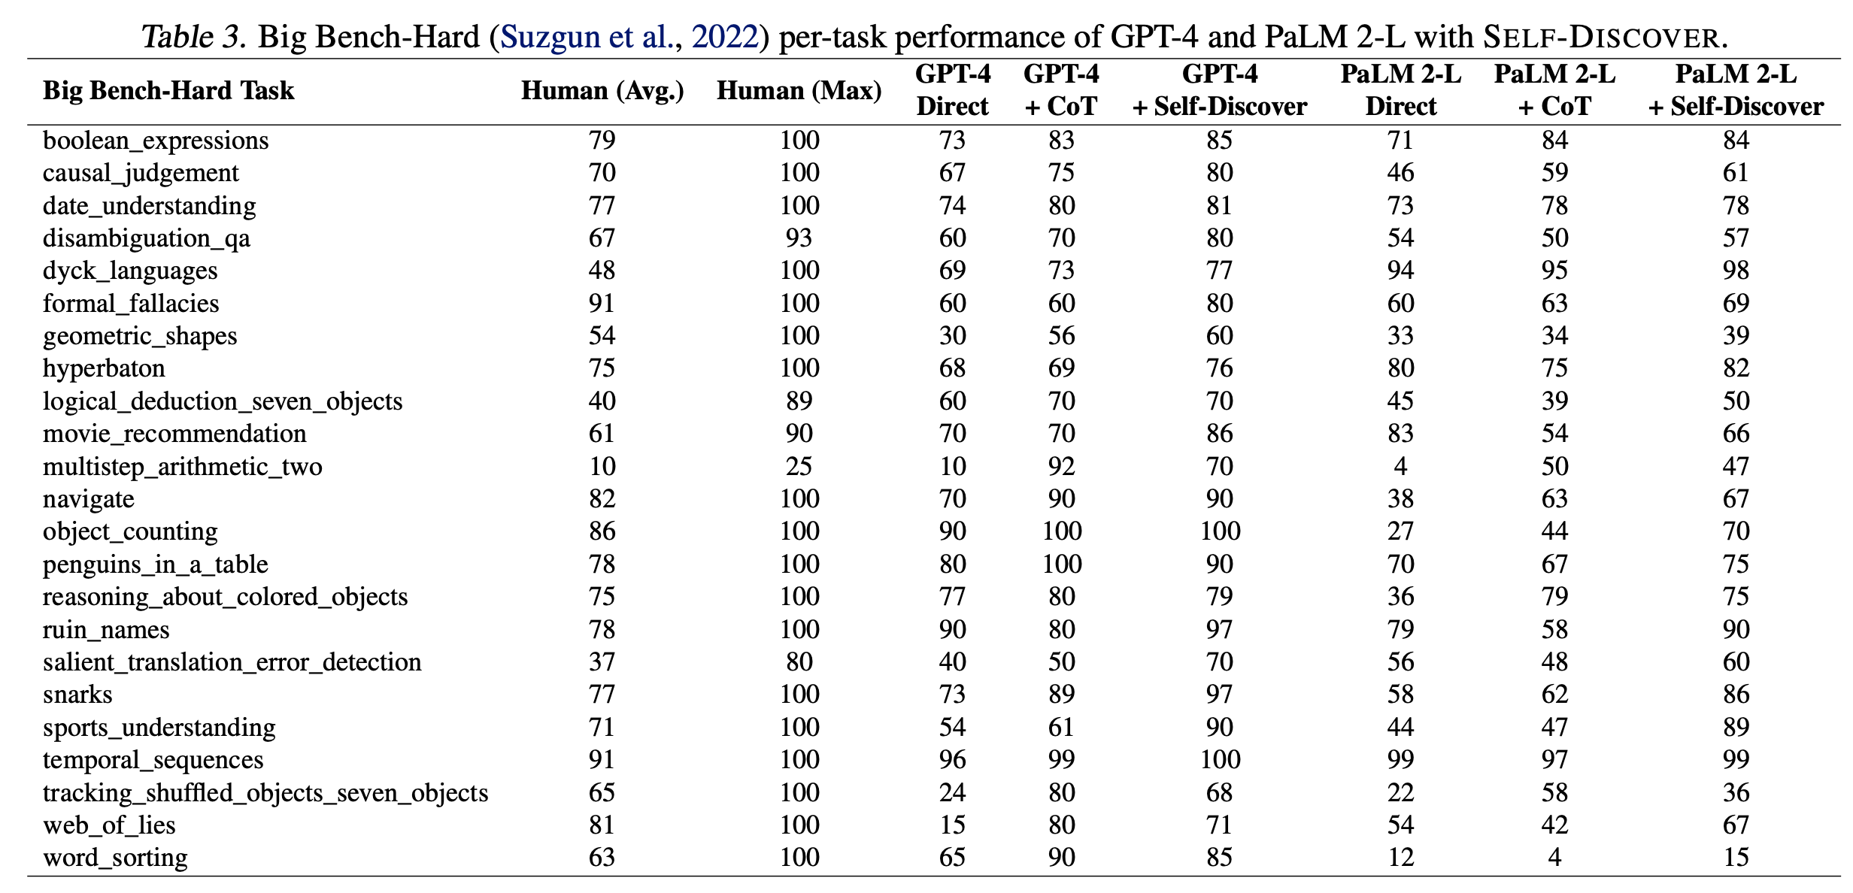
Evaluations on Big Bench-Hard

Slide 16
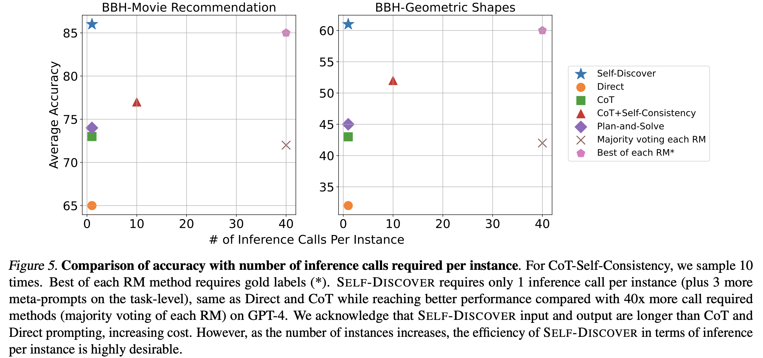

Slide 17
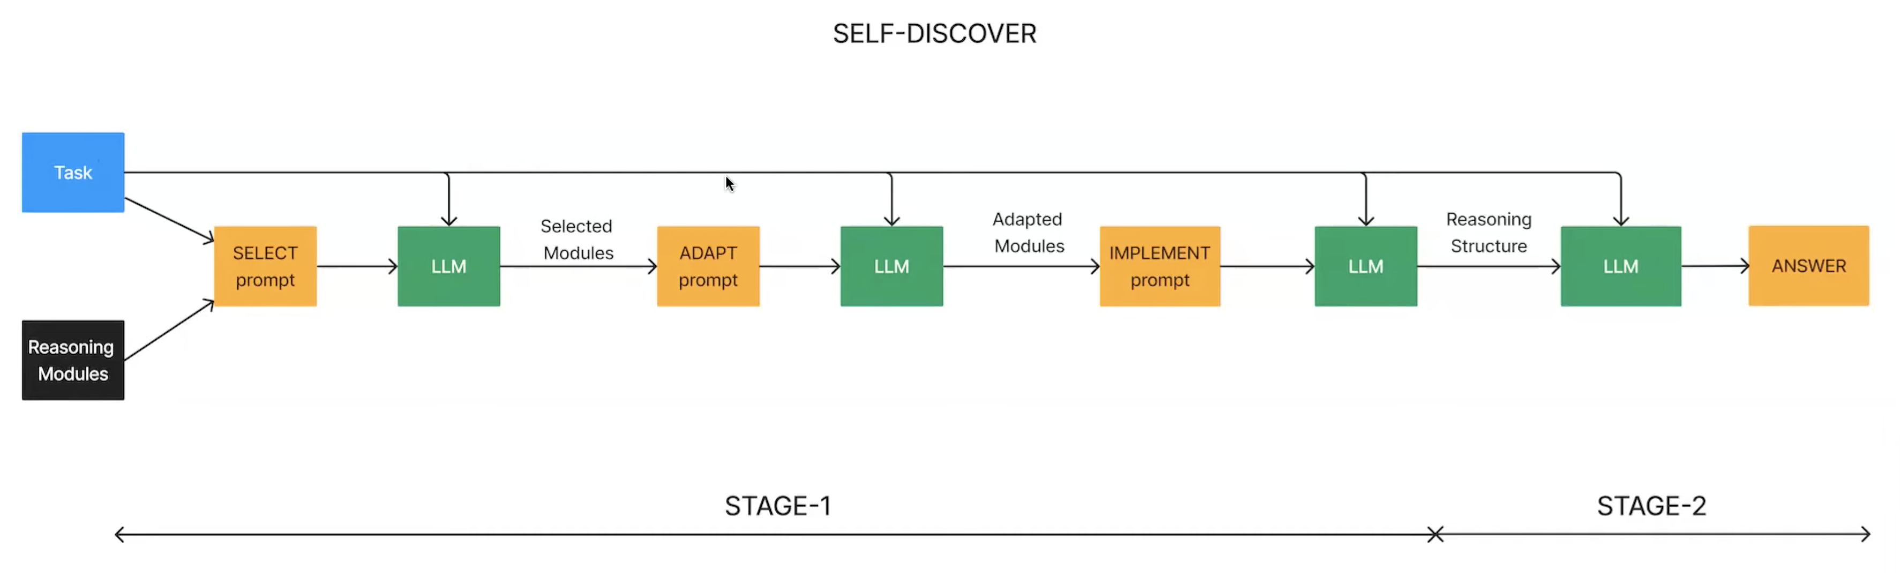
Implementations
Github: https://github.com/catid/self-discover
Llama Index: https://llamahub.ai/l/llama-packs/llama-index-packs-self-discover?from=

Slide 18





youtube.com/@asimmunawar
x.com/asimunawar
linkedin.com/in/asimmunawar
https://asimmunawar.github.io/ (Talks)
Download PPTX
Asim Munawar

